Slide 1


Essential but Unmeasured
Mehlich III predicts that most soils in Wisconsin and Illinois are nickel deficient
Dustin Sawyer, MSc
Phillip Barak, PhD

Slide 2
“Essential”
Arnon & Stout (1939) outlined the criteria of essentiality
A deficiency of the element makes it impossible for the plant to complete the vegetative or reproductive stage of its life cycle
Such deficiency is specific to the element in question, and can be prevented or corrected only by supplying this element
The element is directly involved in the nutrition of the plant, rather than correcting an environmental condition that prohibits vigor
Notes:
Mention copper study – this was how they determined that copper was essential

Slide 3
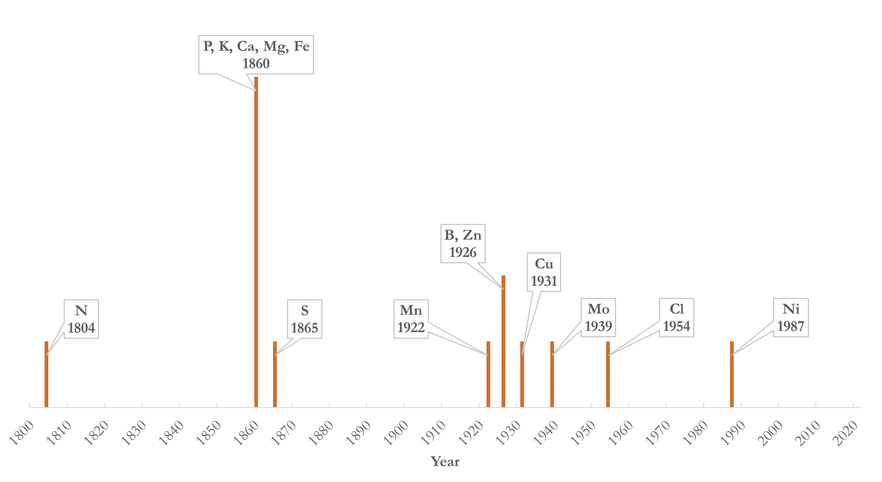
A history of discovery
To date 14 mineral elements have been found to be essential
The activity in the 1860s was primarily two researchers
Activity resumed with the development of new instrumentation
Not yet finished - current work to add Co to the list
C, H, O are not on this graphic but are essential

Slide 4
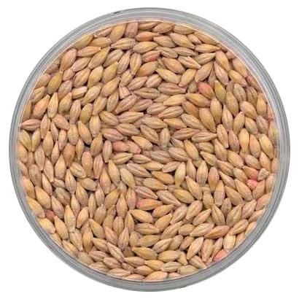
The essentiality of nickel
In 1987 Brown et al. were able to design an experiment that fulfilled the criteria of Arnon & Stout by breeding successive generations of barley with less and less Ni until the seeds were no longer viable
Concluded that “The potential exists, however, for low Ni availability under some soil conditions…Ni deficiency in food and feed crops is a possibility.”

Slide 5
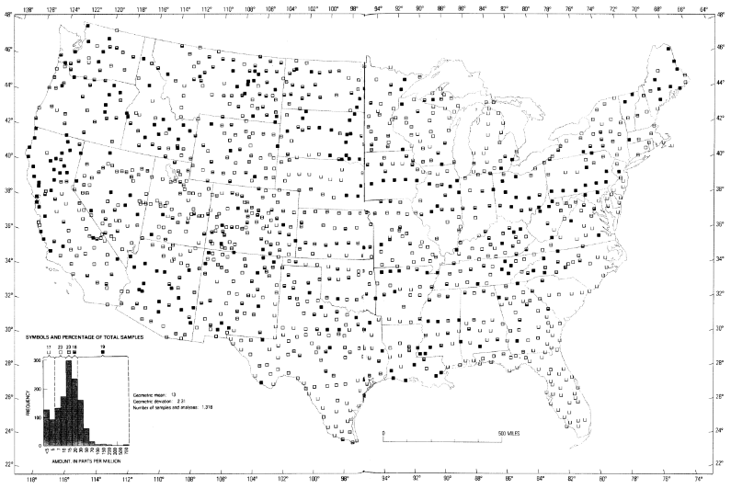
and then…
Excitement, jubilation, and a flurry of scientific discovery?
NOPE
1984 USGS Surficial materials survey showed total nickel concentrations in the soils of the conterminous United States
The critical concentration found by Brown et al was so low (30±10 ng g⁻¹ dry weight) that a deficiency was deemed unlikely

Slide 6
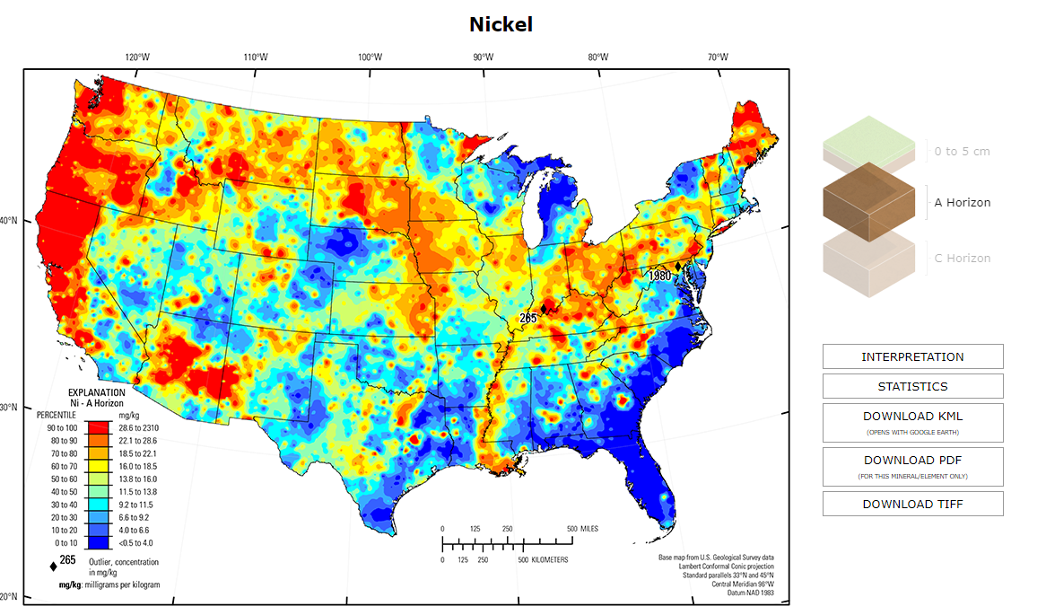
USGS maps were updated in 2017!
Easier to see areas that are relatively lower in total Ni concentrations
Definite regional variation
Ultramafic parent material in the West and Northwest
Quartz dominates in the Southwest
“Low” regions are <0.5 to 4.0 mg kg⁻¹ so still no real concern for crops to fall below critical essentiality level

Slide 7
Nickel as a beneficial element
Roach & Barclay, 1945; Increased yield in wheat, potatoes, and broad beans, foliar applied; UK
Lavres et al., 2016; +84% grain DM yield; soybeans; seed treatment; Brazil
Freitas et al., 2018; As much as 1,502 kg ha⁻¹ yield increase (22.3 bu ac⁻¹); soybeans; soil applied; Brazil
Kumar et al., 2021; Greatest yield increase with 5.0 kg ha⁻¹ soil applied plus 0.2% NiSO₄ foliar applied; barley; India

Slide 8
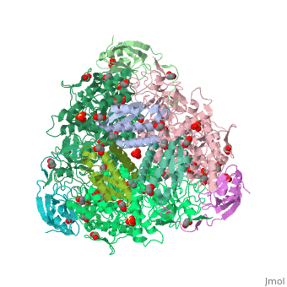
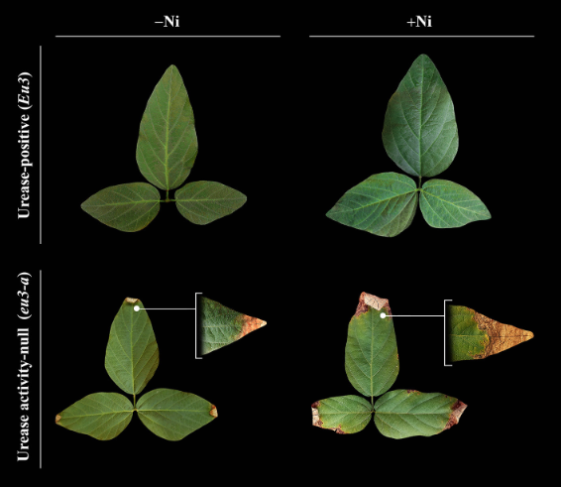
Nickel as a beneficial element
Urease
Nickel was discovered to be a required constituent in 1975
Catalyzes the breakdown of urea into ammonium and carbon dioxide
Without it, we can see urea toxicity in leaves
Urea concentrations
45.8 µmol g FW⁻¹
10.0 µmol g FW⁻¹
85.8 µmol g FW⁻¹
98.2 µmol g FW⁻¹
D. Siqueira Freitas et al. Frontiers in Plant Science(2018)

Slide 9
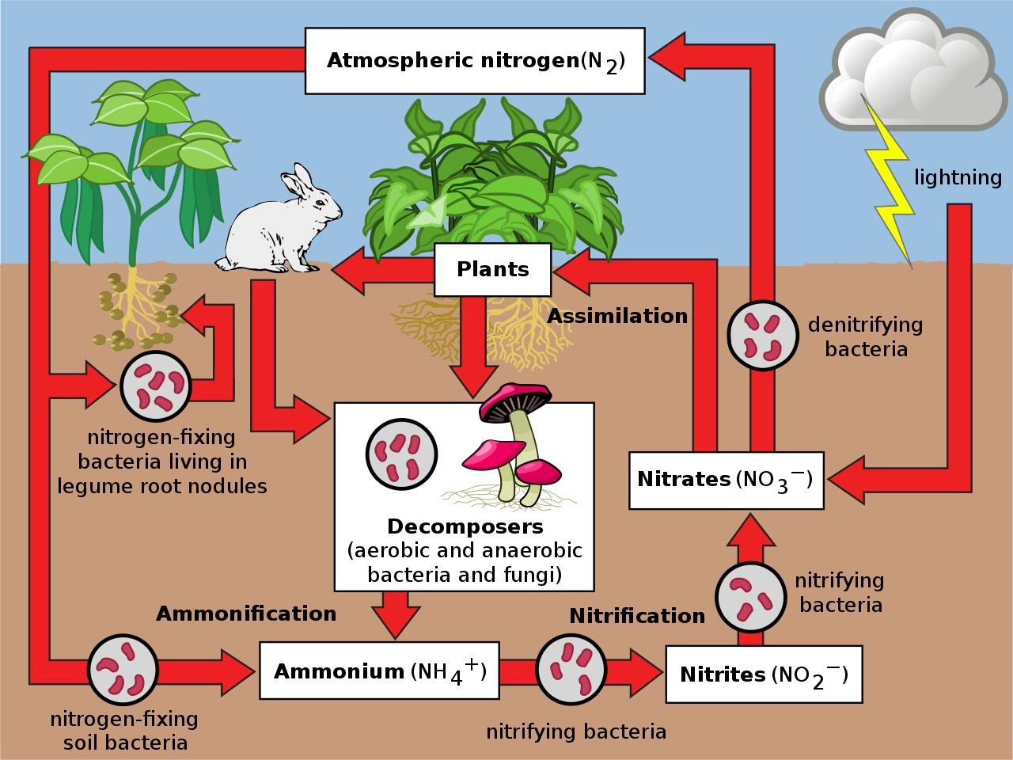
Why does urease matter?
Plants take up nitrate, not urea. It says so right here!
THIS is where it matters
https://www.quora.com/Will-the-nitrogenous-waste-of-animals-like-urine-be-directly-absorbed-by-the-plants

Slide 10
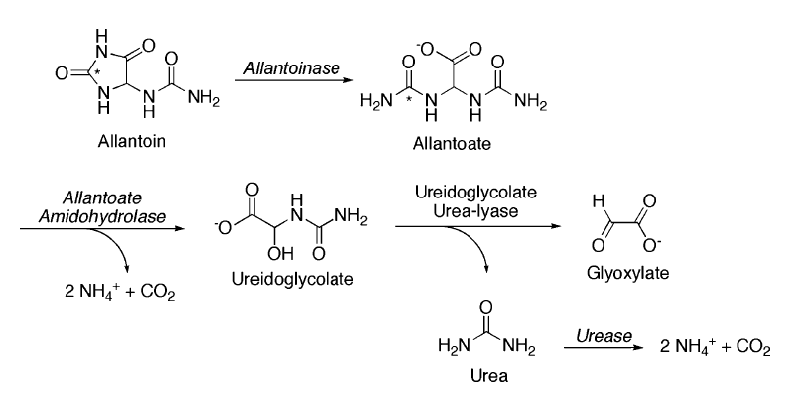
Urea and urease in legumes
Nodules fix ammonia(um) which is transferred to the roots and converted to ureides.
Plant transports ureides from the roots as allantoin and allantoate.
Enzymes eventually break these into urea.
Urease liberates the NH₄⁺.
C. D. Todd et al. Journal of Experimental Botany(2006)
Notes:
Ammonia is fixed in nodules, conveyed across membrane as ammonium, plant synthesizes allantoin to prevent ammonium toxicity. Lots of carbon is shipped from shoots to roots to allow for allantoin creation.

Slide 11
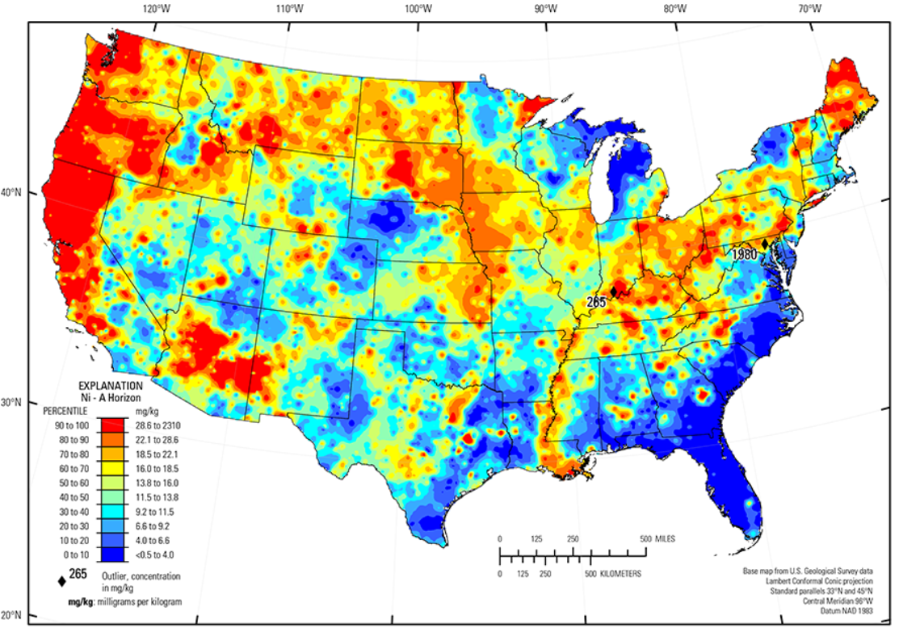
Increased urease activity
1985 Dalton et al. found increased urease activity in response to added Ni in a soil with 13 ppm total Ni.
13 ppm is roughly the median value in the conterminous US

Slide 12

Things I’ve said
That should bother you
The USGS total nickel concentrations are not helpful agronomically
We need a plant available test
Brown et al. critical level (30 ppb in tissue) is not helpful agronomically
We need to know the agronomic critical level

Slide 13
Nikoli & Matsi 2014
Evaluated several existing soil extractants for efficacy with nickel
DTPA, AB-DTPA, AAAc-EDTA, Mehlich III, 0.1 M HCl, 0.1 M HNO₃
First attempt to develop sufficiency critical levels in the soil
Best efficacy with AAAc-EDTA and Mehlich-3
Determined critical level to be ~2 mg kg⁻¹ for these methods, using Cate-Nelson procedure
Used ryegrass as the crop
Notes:
Ammonium bicarbonate DTPA, acid ammonium acetate EDTA

Slide 14
Nikoli et al. 2016
Multiple extractants and multiple calibration techniques
DTPA, AB-DTPA, AAAc-EDTA, Mehlich III extractants
Mitscherlich-Bray equation, Graphical technique of Brown et al., Cate-Nelson graphical technique
Still used ryegrass

Slide 15
Nikoli et al. 2016
Table 1: Critical levels of extractable Ni (mg kg ⁻¹)
Calibration technique | DTPA | AB-DTPA | Mehlich III | AAAc-EDTA
Cate and Nelson | 0.5 | 1.0 | 1.3 | 1.1
Mitscherlich-Bray | 2.1 | 2.2 | 3.7 | 5.1
Brown et al. | 2.3 | 1.8 | 5.3 | 6.0

Slide 16
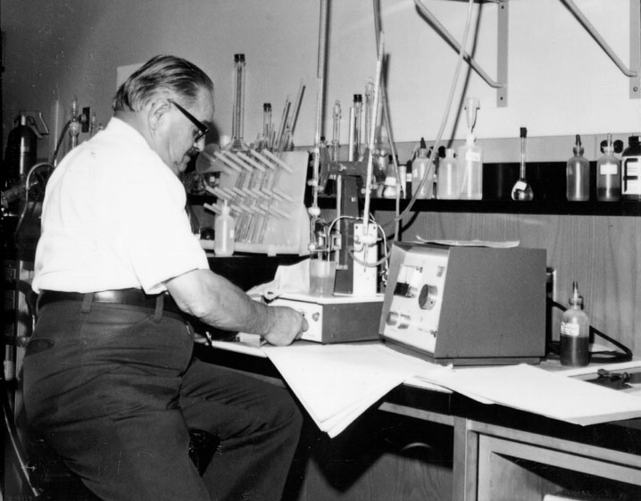
Sidebar: A brief history of the Mehlich extractant
Dr. Adolf Mehlich working at North Carolina State University
1953?: Mehlich I, AKA Double Acid extractant is the first universal extractant. A general success, it doesn’t work well in all soil types, particularly non-acid soils
1978: Mehlich II tried to rework Mehlich I to include more soil types, broader pH range. Again, mostly successful but lost efficacy of Cu extraction
1984: Mehlich III aimed to reduce the corrosivity of Mehlich II, and improve Cu extraction with addition of EDTA (published posthumously)

Slide 17
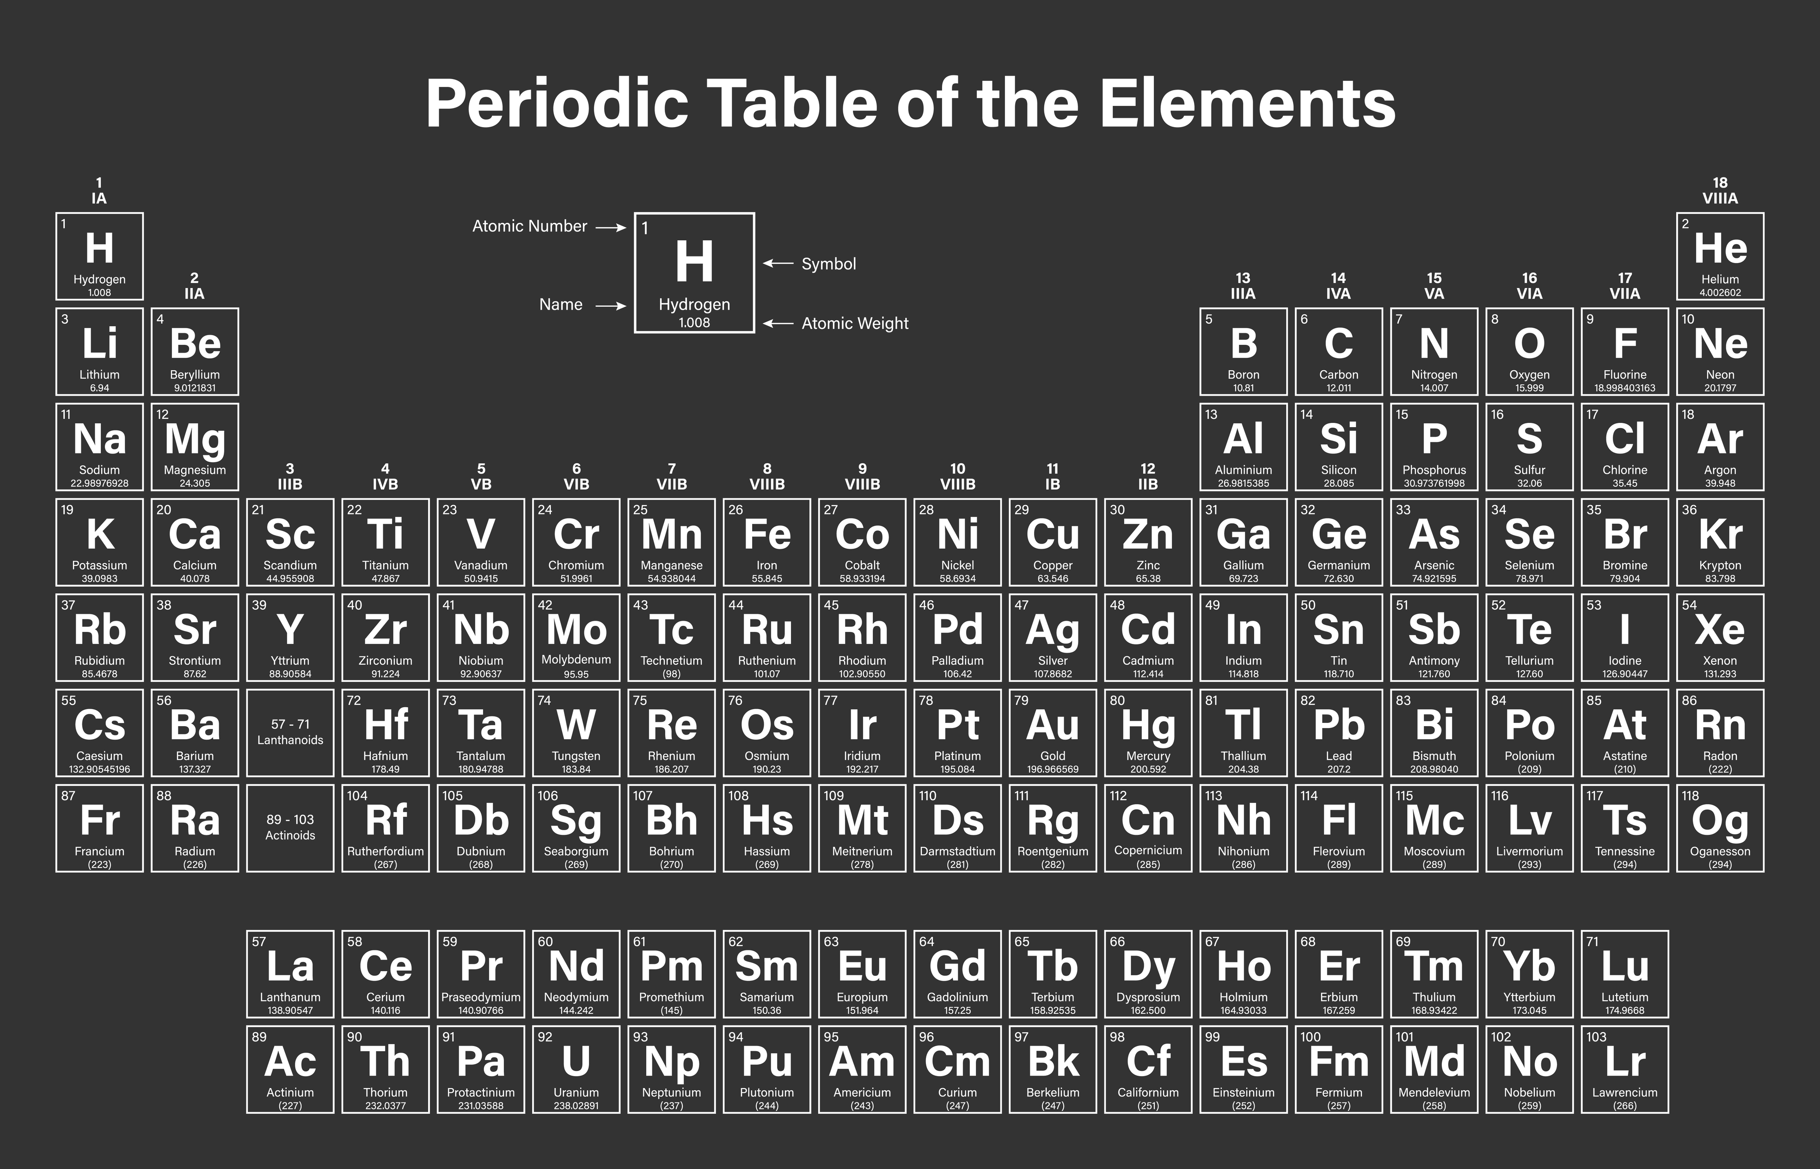
Mehlich III
Vs
Mehlich II
Zn +25%
Mn +50%
Cu +170%

Slide 18
Sawyer & Barak, 2020
Assessed Mehlich III extractable nickel content in Midwestern USA and compared to critical levels determined by Nikoli et al., 2016
Will data indicate that nickel fertilization may provide a benefit to crop production in these soils?
Assess regional differences in nickel concentrations as well as relationships among nickel and other soil properties
Observational study with no experimental variables

Slide 19
Sawyer & Barak, 2020
Nickel was quantified on all samples submitted for Mehlich III analysis
~39,000 samples collected throughout Wisconsin and Illinois April to October 2020
Samples collected by customers following a myriad of protocols
Little is known about the fields that were sampled for the study

Slide 20
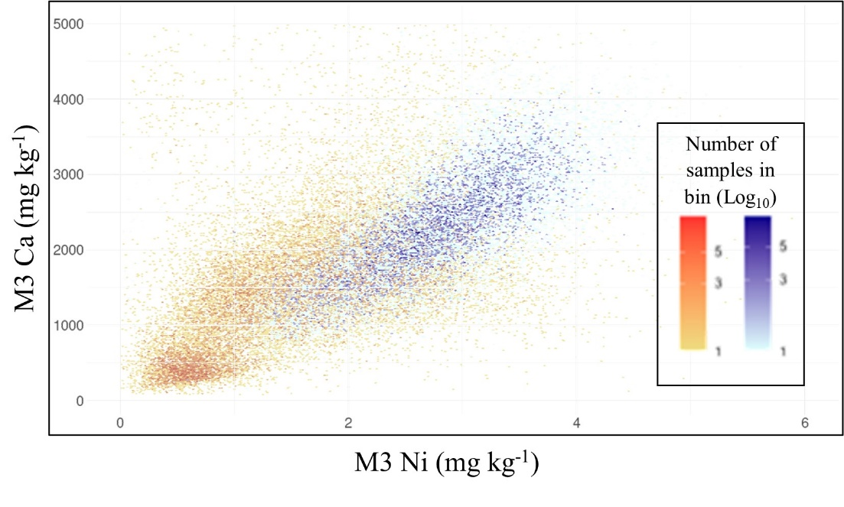
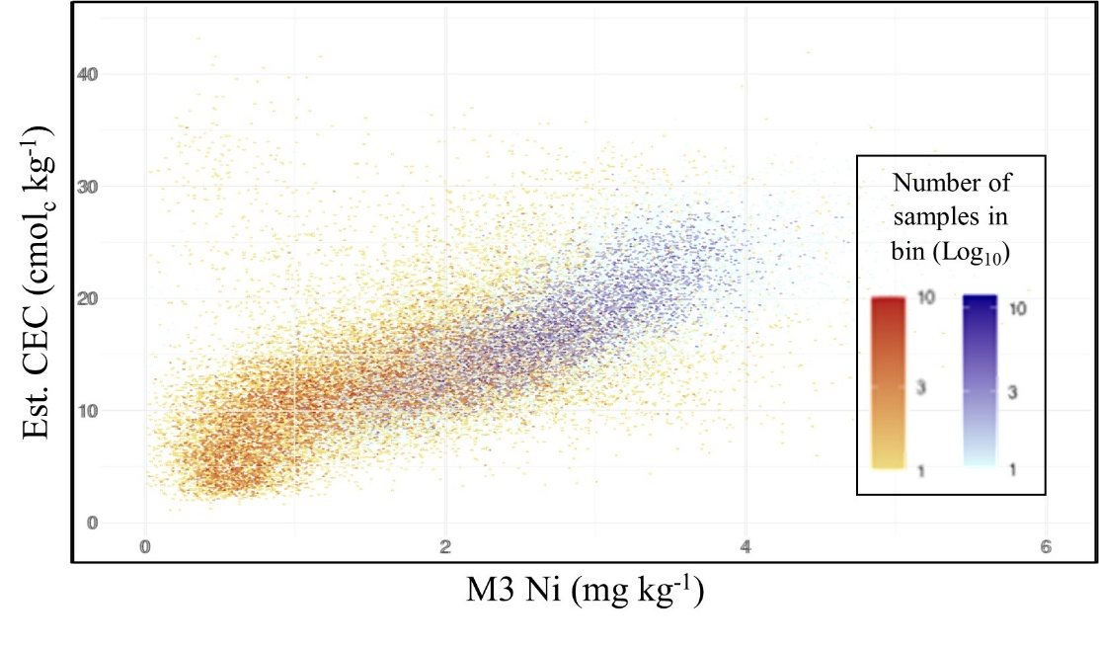
Interesting correlations
Relationship between Mehlich III Ca and Mehlich III Ni, segregated into Wisconsin (red/yellow, n=23,814) and Illinois (blue/cyan, n=13,690) categories, presented as a heatmap
So much data!!
We built a web-based explorer to better sort and display the data
Relationship between estimated CEC and Mehlich III Ni, segregated into Wisconsin (red/yellow, n=23,814) and Illinois (blue/cyan, n=13,690) categories, presented as a heatmap

Slide 21
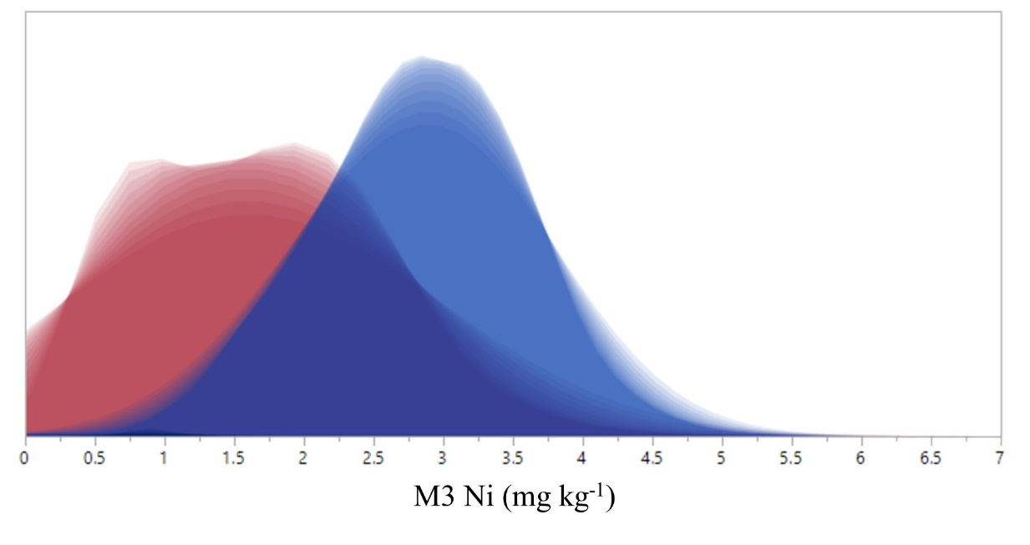
Sawyer & Barak, 2020
Mehlich III extractable nickel concentration distribution by state
“Wisconsin” samples
“Illinois”
samples
Notes:
Wisconsin samples were collected by dozens of different customers all across the state and may have some samples from Eastern MN, Iowa, and N IL whereas Illinois samples were collected primarily by three customers and may include a little Southern WI and Western IN. Again we don’t have the exact locations of samples

Slide 22
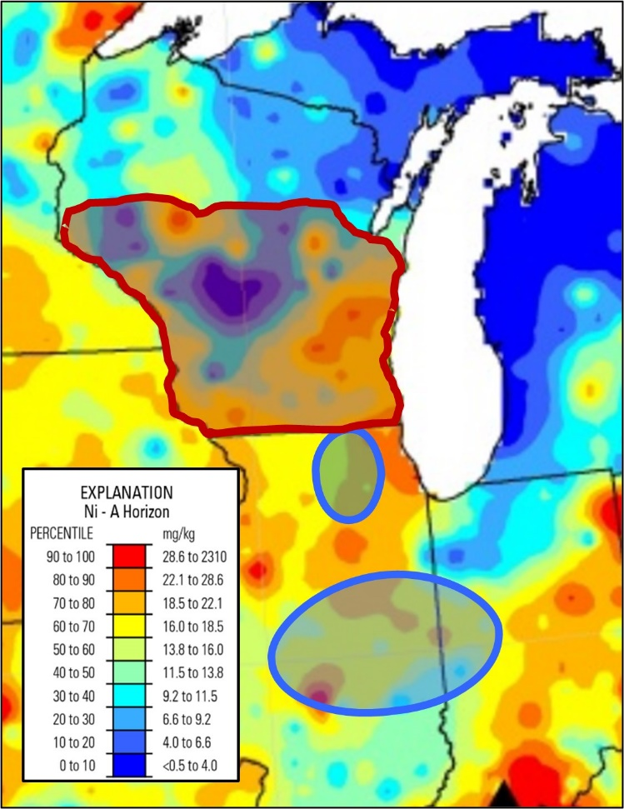
USGS total nickel concentrations, 2017
“Illinois” samples come from areas more uniformly high in total Ni than “Wisconsin” samples
This suggests there is a relationship between total and M3 Ni concentrations
Notes:
Blue area in WI is central sands region, red area is calcareous soil

Slide 23
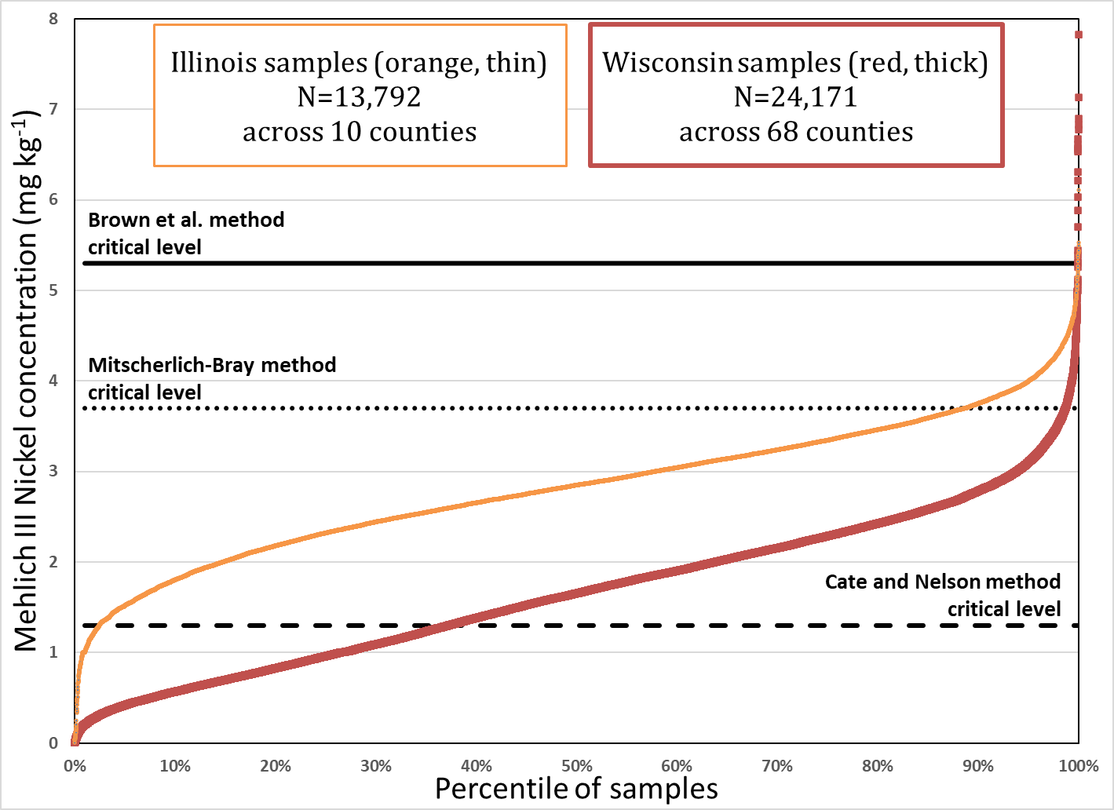
Sawyer & Barak, 2020
Percent of samples
below each critical level
Critical level (mg kg⁻¹) | Calibration technique | WI percent below | IL percent below
1.3 | Cate and Nelson | 37.3 | 2.4
3.7 | Mitscherlich-Bray | 98.7 | 88.7
5.3 | Brown et al. | 99.9 | 99.9
Cumulative distribution by state

Slide 24
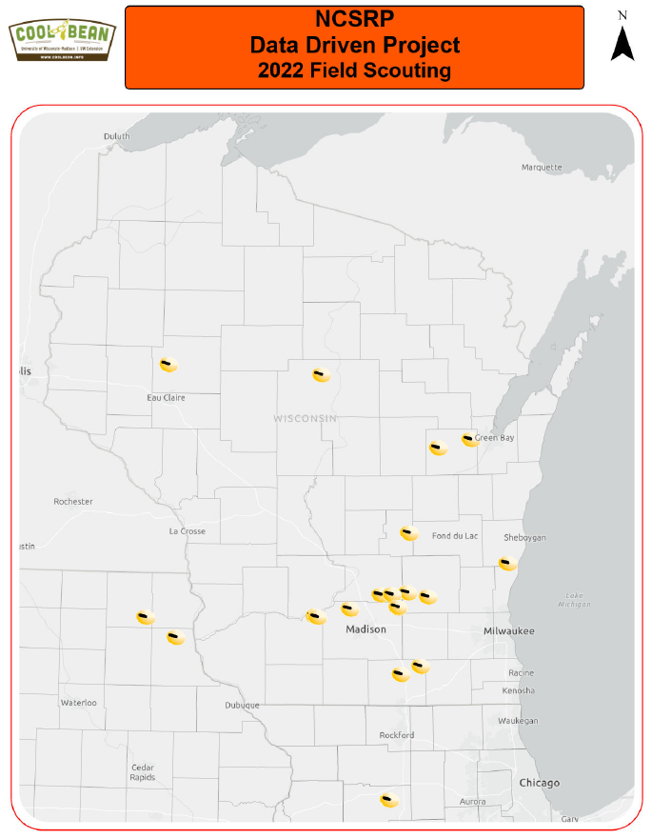
Further work - 2022
M3 Ni x soybean yield observational study
  Dr. Shawn Conley, UW Dept. of Agronomy
  17 sites across WI, Northern IL, & Northwestern IA
  626 soil samples total
Data analysis is underway

Slide 25


Further work - 2023
Bringing nickel back
Ni incubation and application studies in southern WI
  How does Ni application:
    move M3 Ni?
    Impact urease activity
    Impact bean yield

Slide 26
Interesting nickel facts
In 1751 Swedish mineralogist Axel Fredrik Cronstedt was the first person to realize that nickel was a new element
The name comes from the German word Kupfernickel, meaning “Old Nick’s copper.”
Twice as abundant as copper, nickel constitutes about 0.007 percent of Earth’s crust
Nickel is only one of three naturally occurring elements that is strongly magnetic. The other two are iron and cobalt.
Adding nickel to glass gives the glass a green color.
http://justfunfacts.com/interesting-facts-about-nickel/

