Slide 1


Some Components of QA/QC in Soil Testing at NCDA&CS
MASTPAWG 2023
February 22, 2023
David H. Hardy

Slide 2
Trained Staff
Standard Operating Procedures – all lab aspects
  New staff shadow and train with senior chemist
Ethics training and sign-off
Safety training and job safety analysis at each station

Slide 3
Possible Mistakes / Errors
Samples out of order
Transposing lab numbers
Wrong samples pulled off shelves
Worn scoops
Wrong scoops used
Double scoops
Filter paper failure
ICP carryover
ICP missed vials
Standards / extractants problems
ICP tubing plugs
Contamination of blank / stds
Faulty pH electrode
Pumps not calibrated
Contaminated lab water
Cold lab temperatures
Wrong client gets report

Slide 4
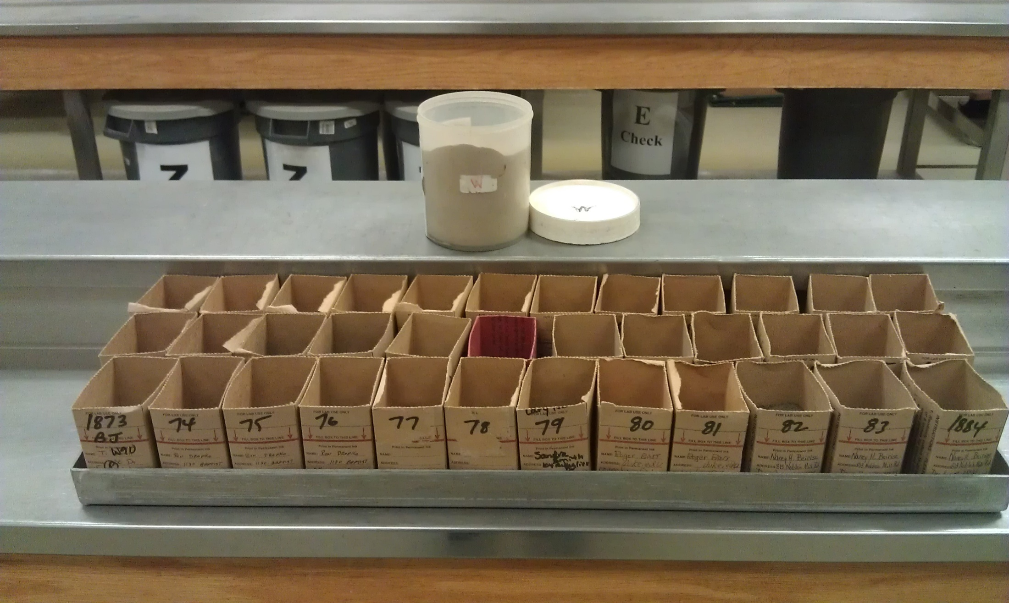
Check Soil- 1 / 36 samples

Slide 5
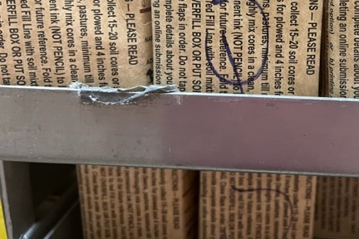
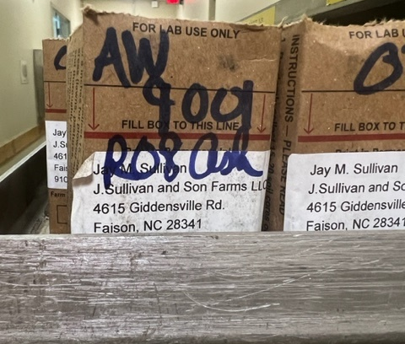
Sample Order / Handling

Slide 6
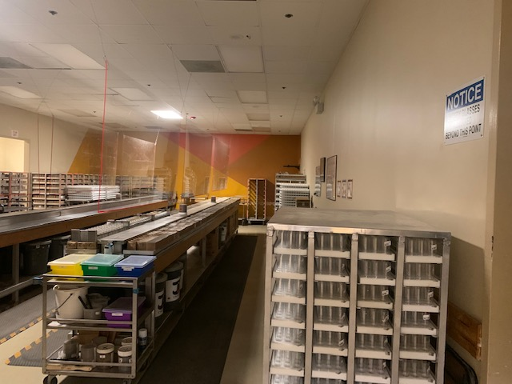
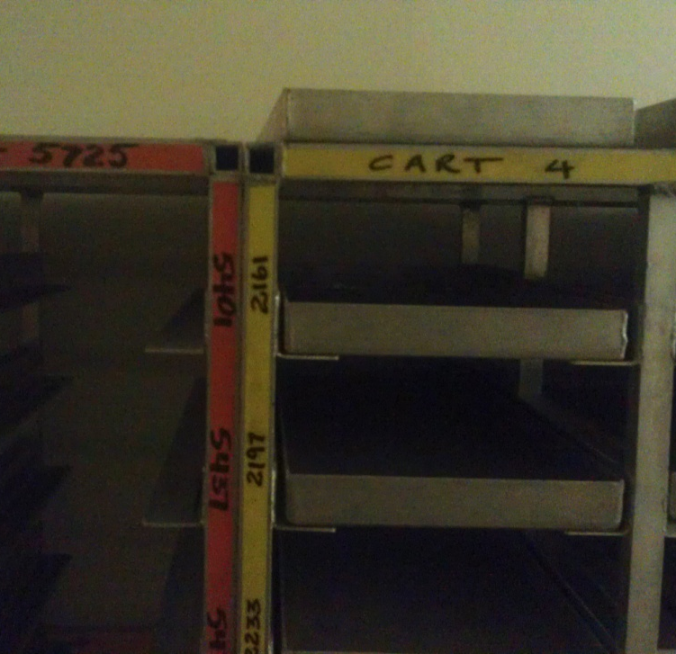
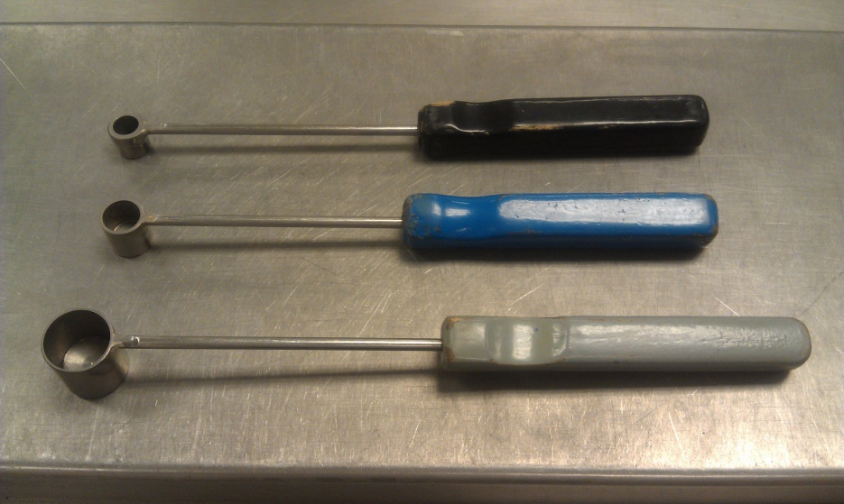
Correct Samples and Correct Scoops
260 sets per series – 3 series

Slide 7
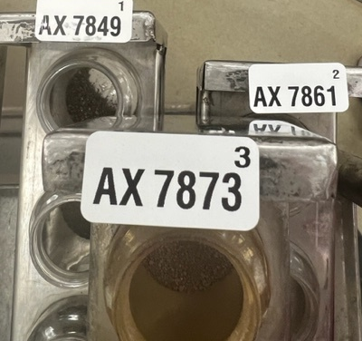
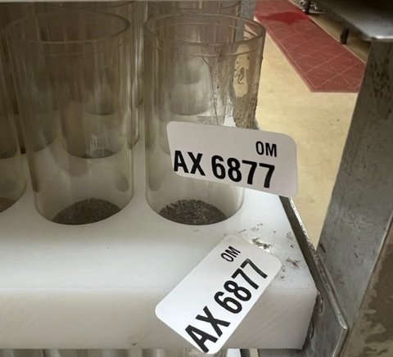
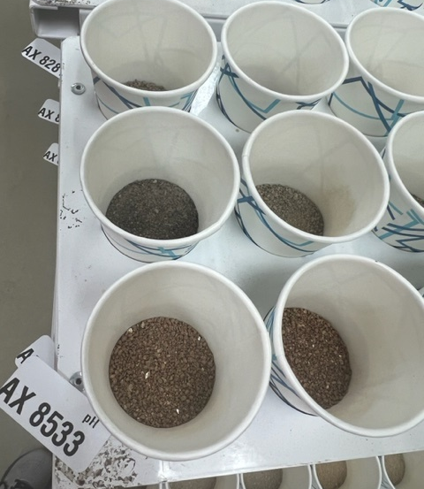
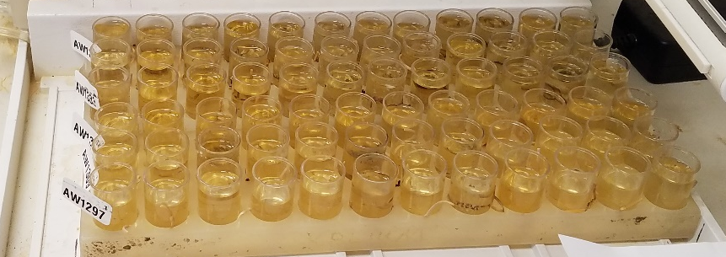
Sample Order & Labeling
Mehlich 3
Humic Matter
VW / pH - BpH

Slide 8
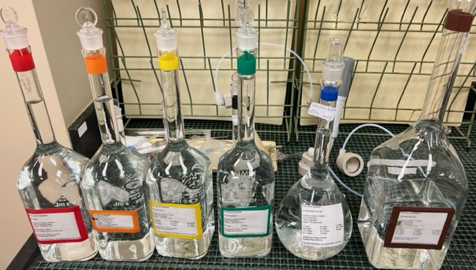
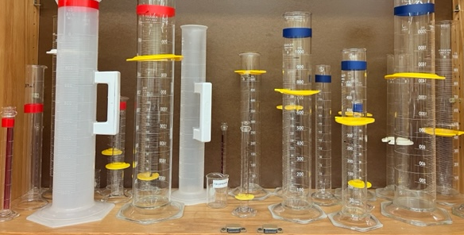
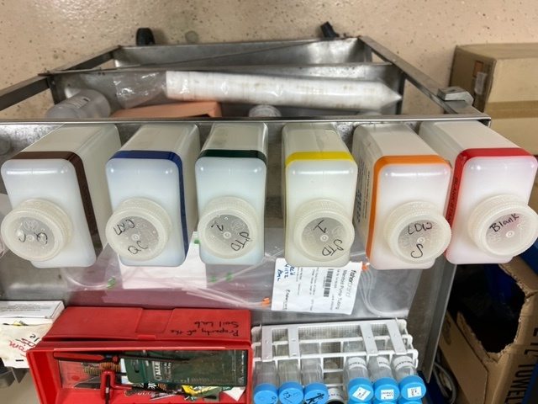
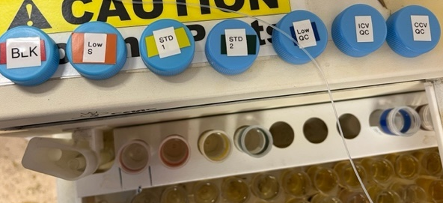
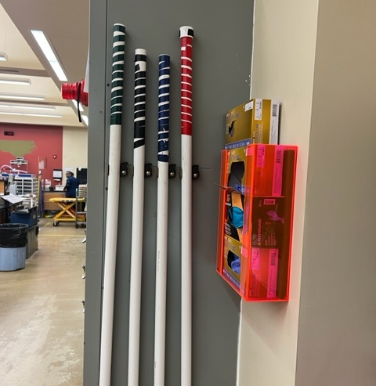
Color & Labeling to
Minimize Mistakes / Confusion

Slide 9
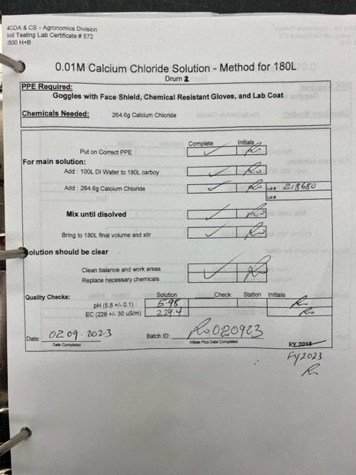
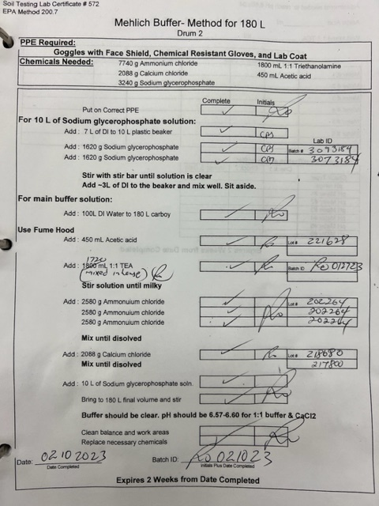
Traceability and Accountability

Slide 10
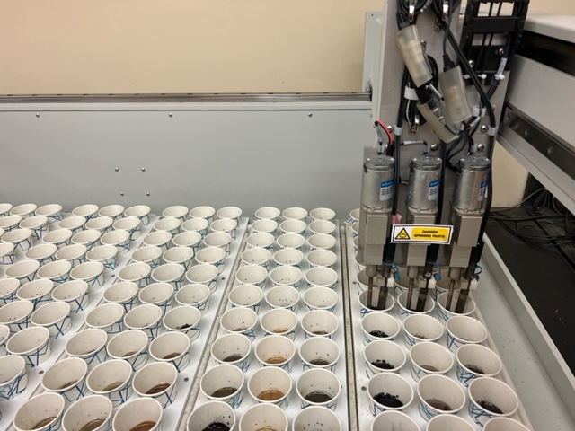
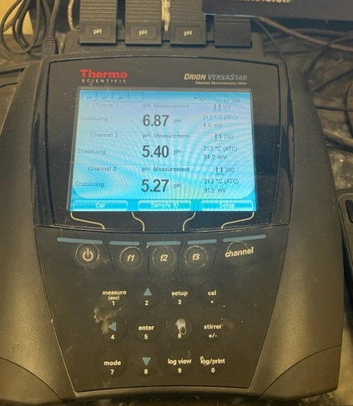
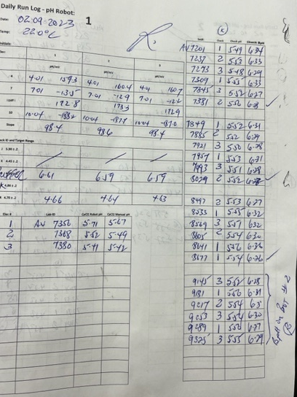
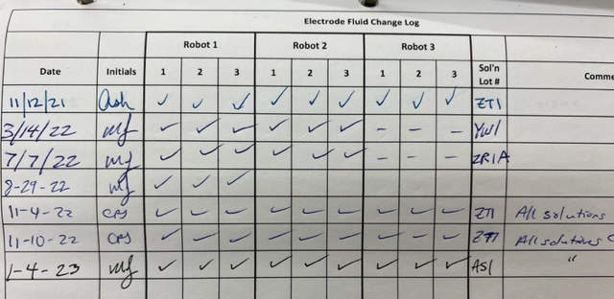
Traceability and Accountability

Slide 11
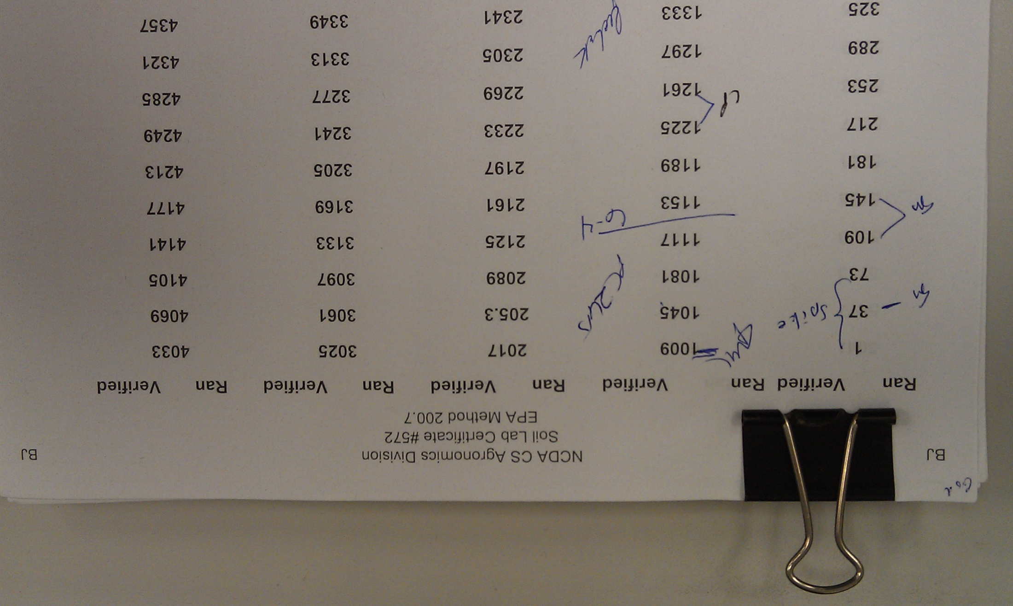

ICP Setup – Speed Component
Blank- 5% nitric acid
Standards in 5% nitric acid
  Low P, S (Low Std.)
  K, Ca, Mg, Na, Mn, Cu, Zn, Al, Fe (Std 1)
  P & S (High Std2)
Low QC (ICV, low QC)
QC (initial) – ICV
Continuous QC (CCV)
Check soil random in set

Slide 12
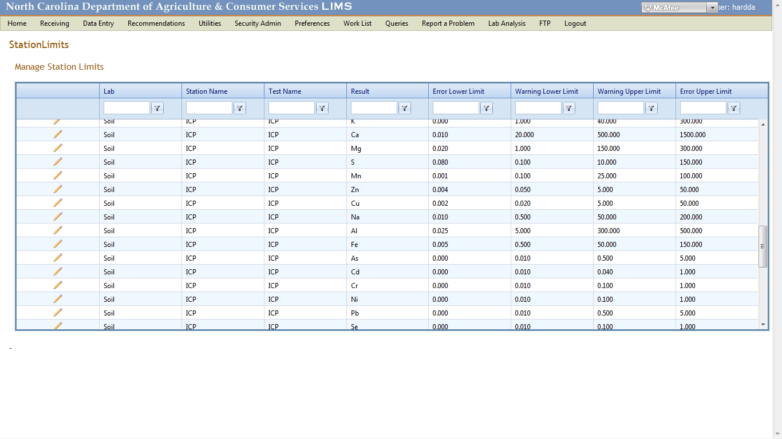
Carefully Set ICP Element Limits

Slide 13
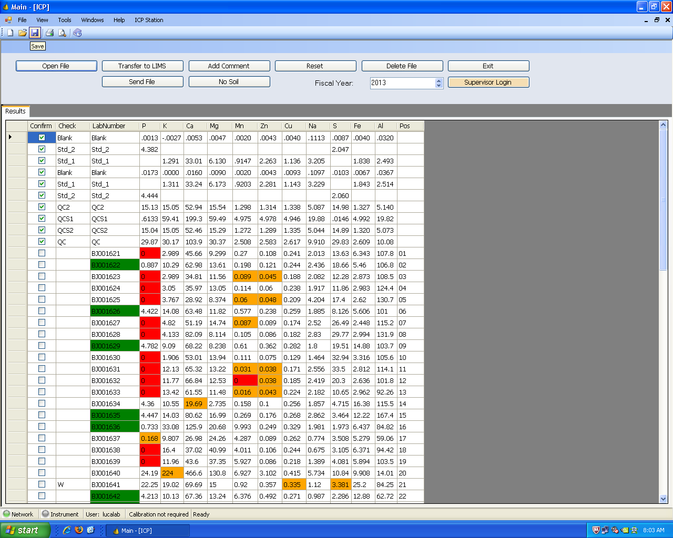
Green – Data in LIMS
Orange – out of range
Warning limit
Red – out of limit
Error limit
Check sample

Slide 14

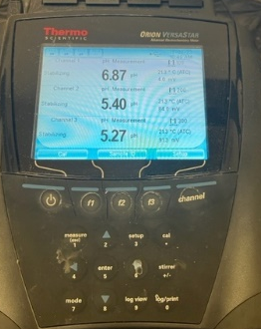
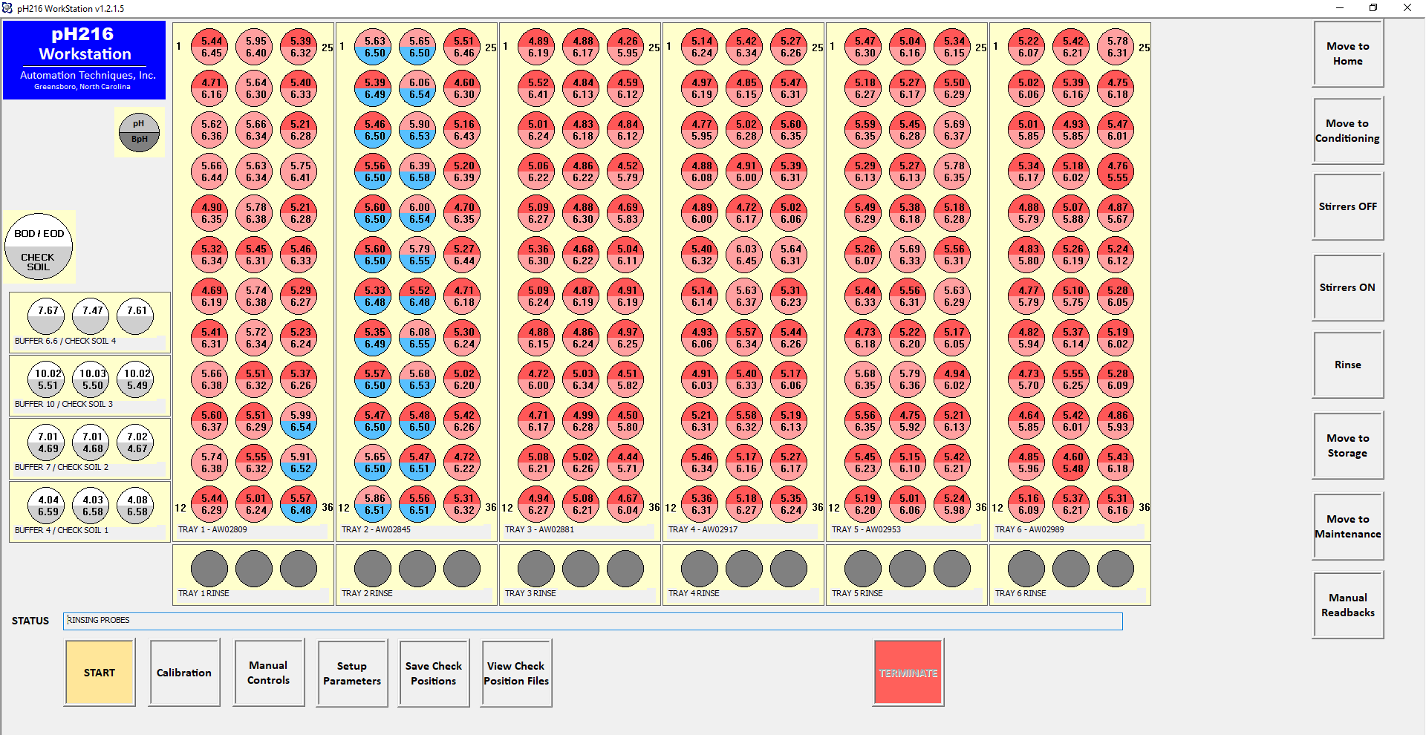
pH / BpH Stds- 4, 7, 10

Slide 15
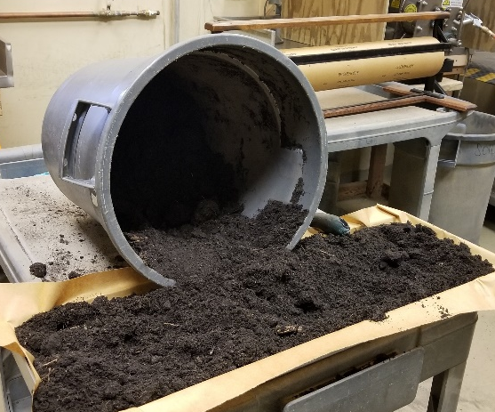
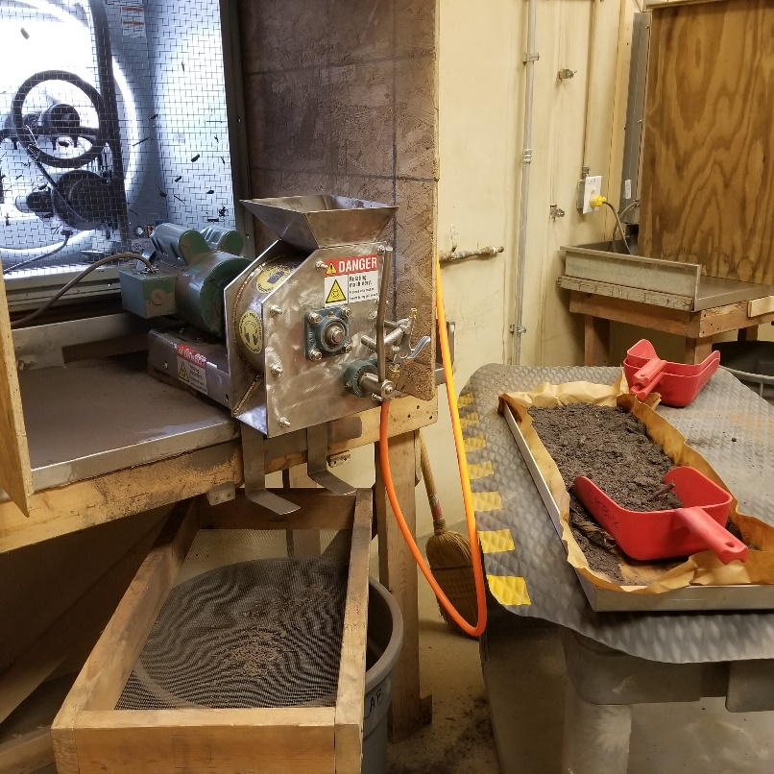
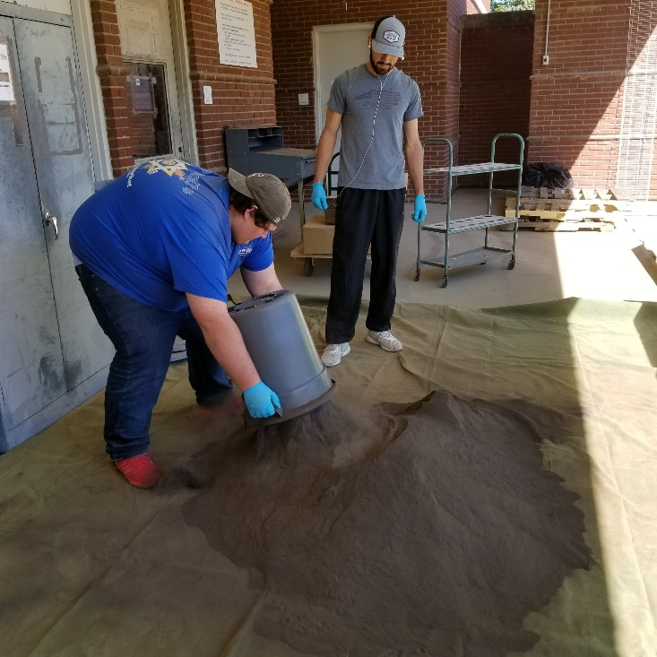
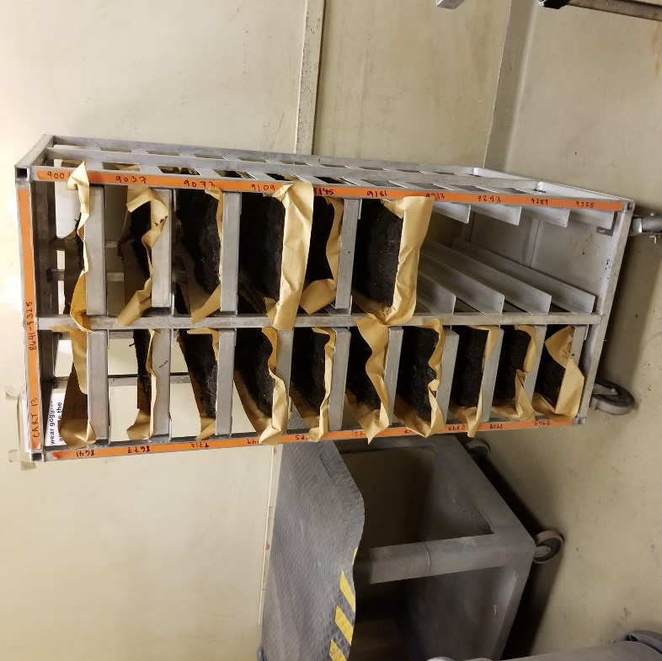
Check Sample Preparation

Slide 16
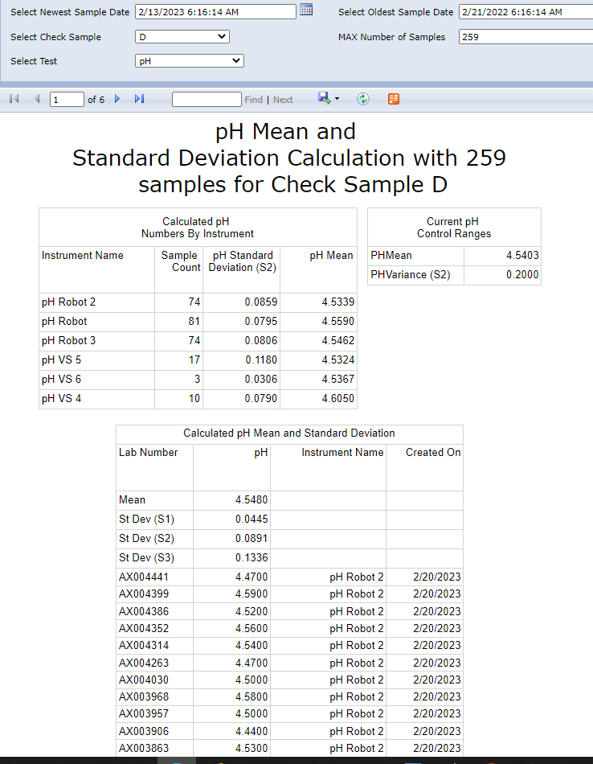
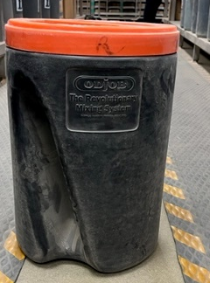
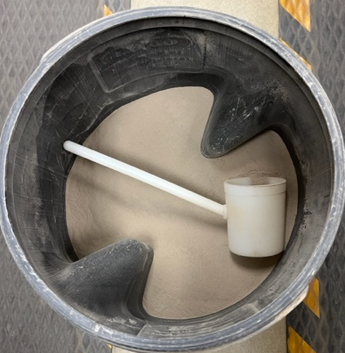
Check Sample

Slide 17
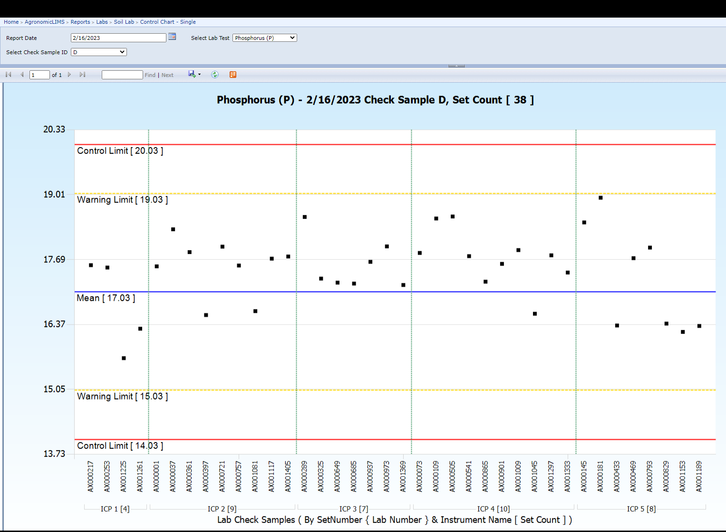
Daily Control Charts

Slide 18
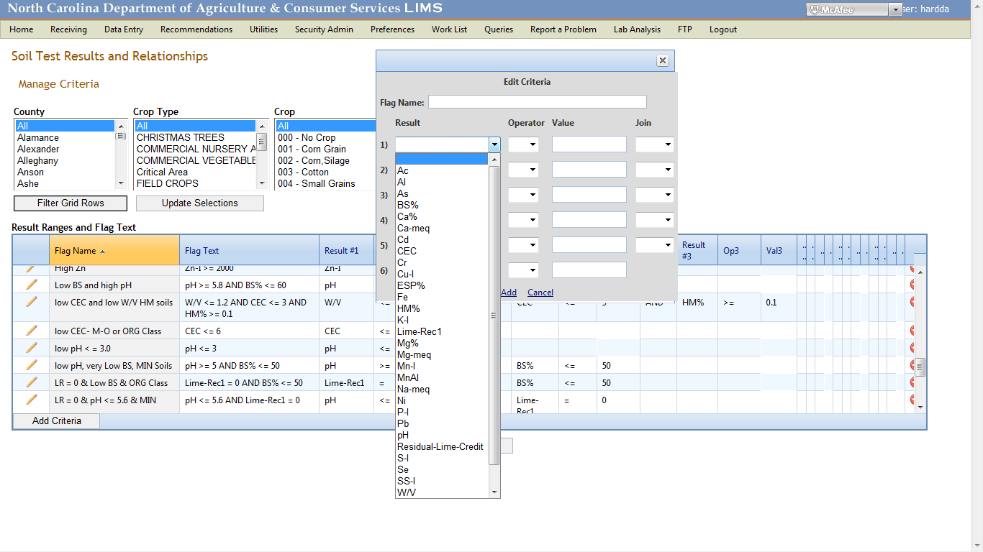
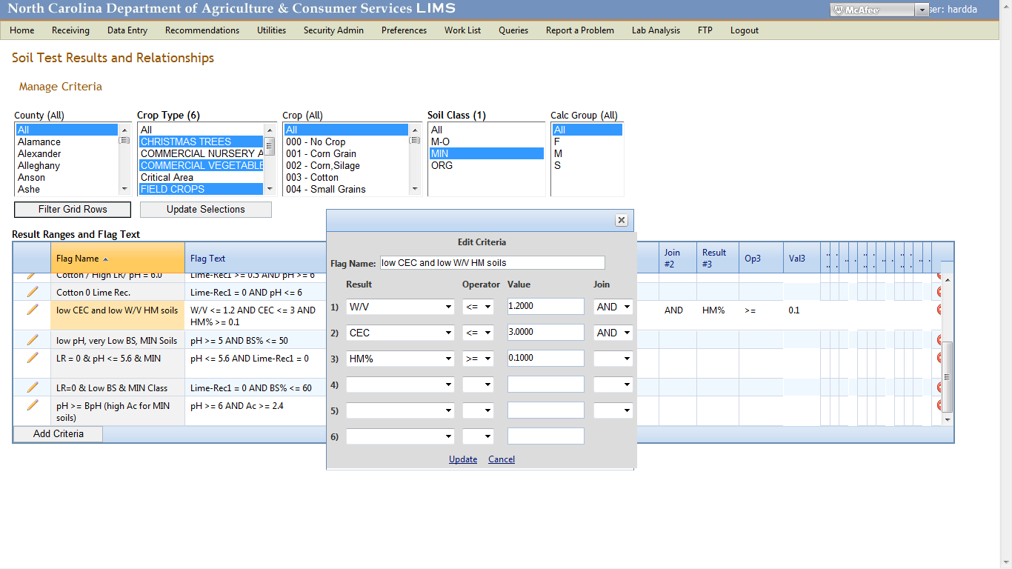
Validation of Data - Agronomist Rechecks
Research samples – at least 10% reruns
Flags identify concern – soil test data relationships

Slide 19
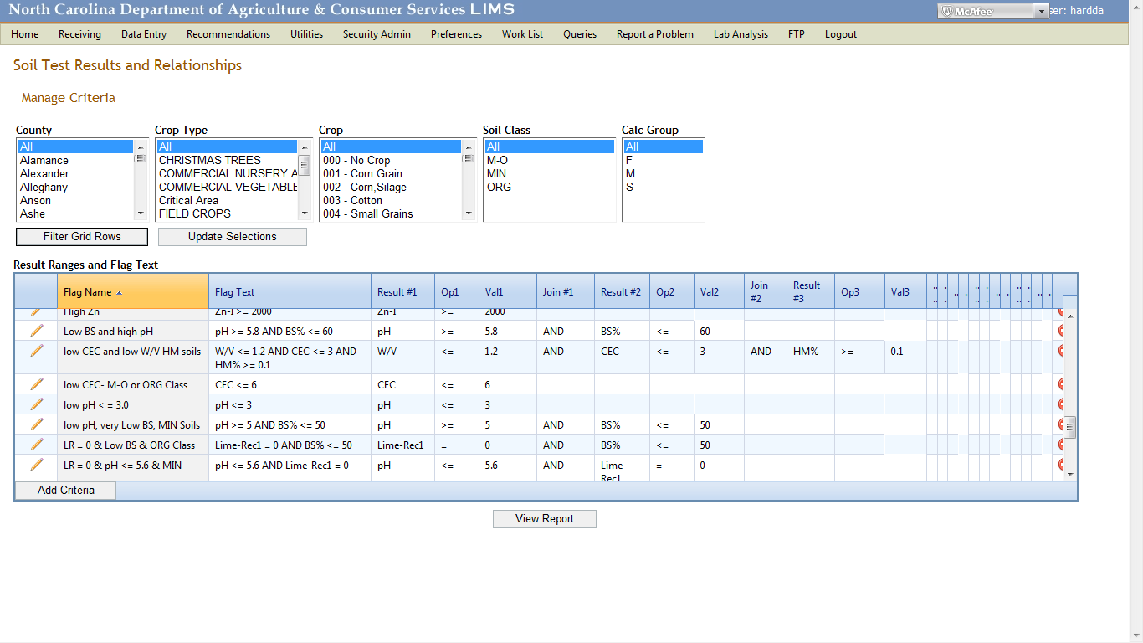

Slide 20
Validation of Data Agronomist Rechecks
Flags identify the concern
  Soil test data limits
Client reports with soil test limit flags
  Held at analyzed status for agronomist review

Slide 21
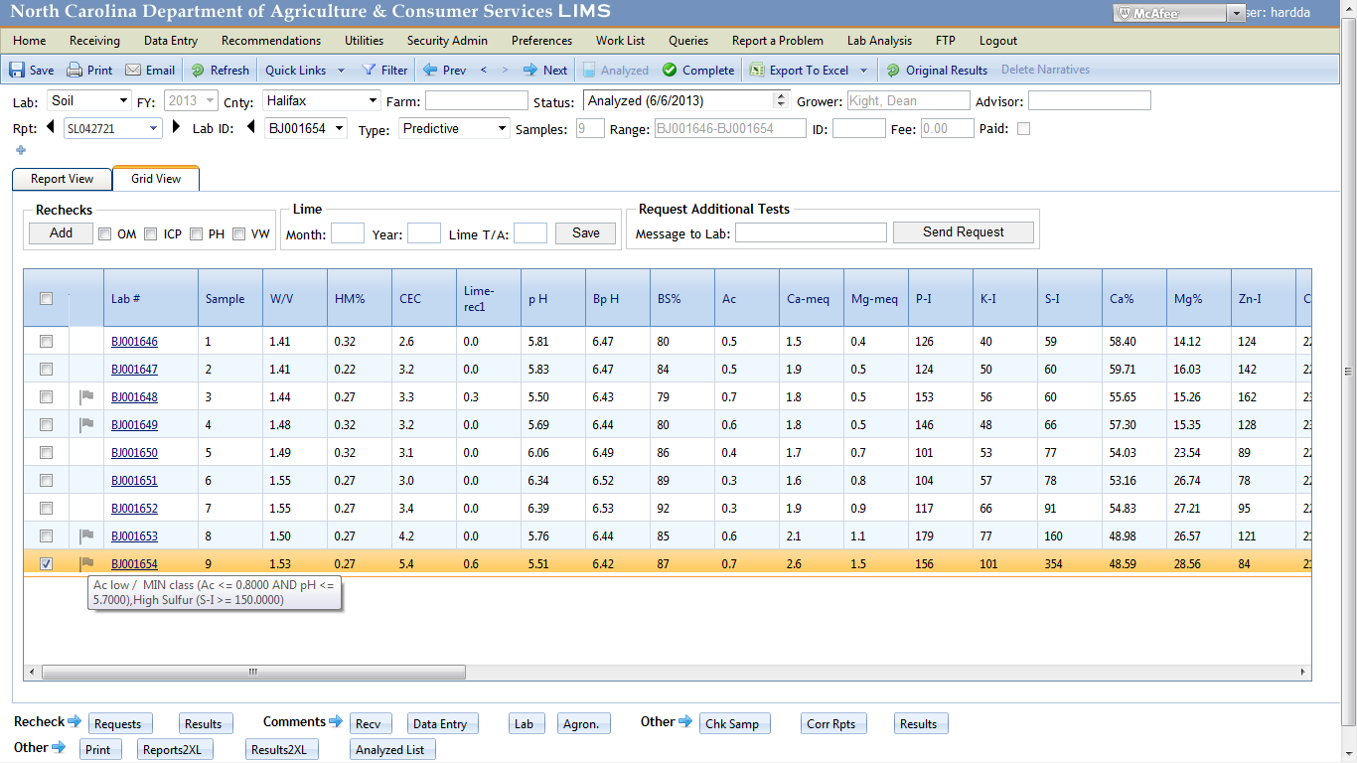
Agronomist View of Flags

Slide 22
Validation of Data Agronomist Rechecks
Flags identify the concern – 3rd day in lab
Client reports with soil test limit flags
  Held at analyzed status for agronomist review
Agronomist selects rechecks - back to lab in batch
  Used in place of grower duplicate

Slide 23
Selecting Rechecks for Tests

Slide 24
Validation of Data Agronomist Rechecks
Flags identify the concern as set through soil test data limits
Client reports with soil test limit flags are held at analyzed status for agronomist review
Agronomist selects rechecks and sends back to lab
Agronomist reviews recheck data
  Resolves
  Request further rechecks or runs
Publish all reports for that day

Slide 25
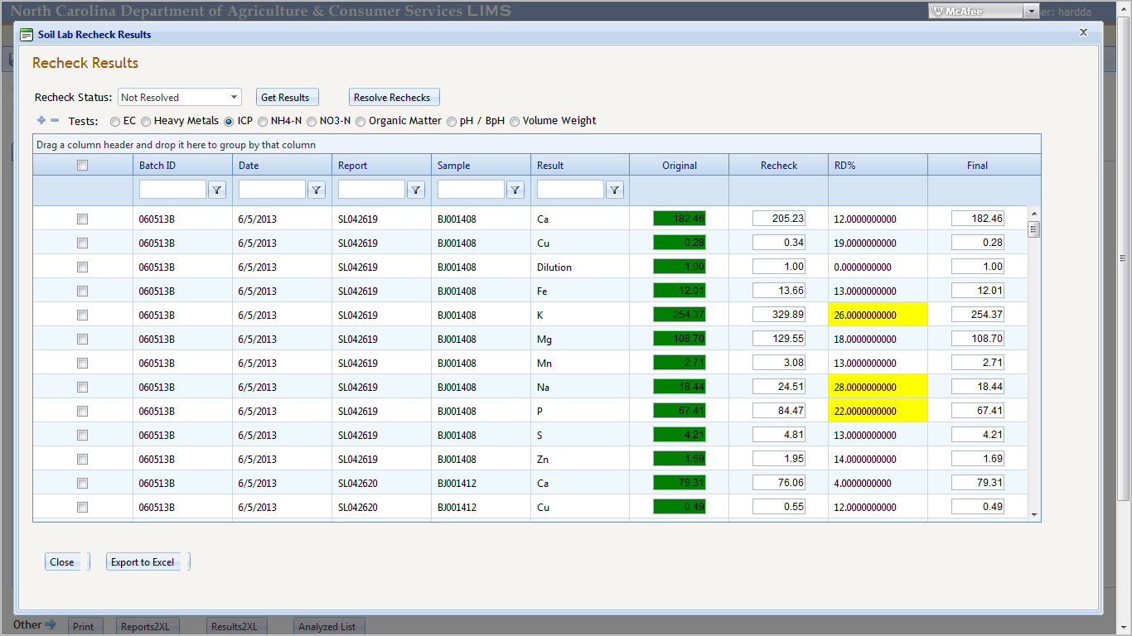
Recheck Results- ICP Batch
Report # Lab # Element Original Recheck %RD

Slide 26
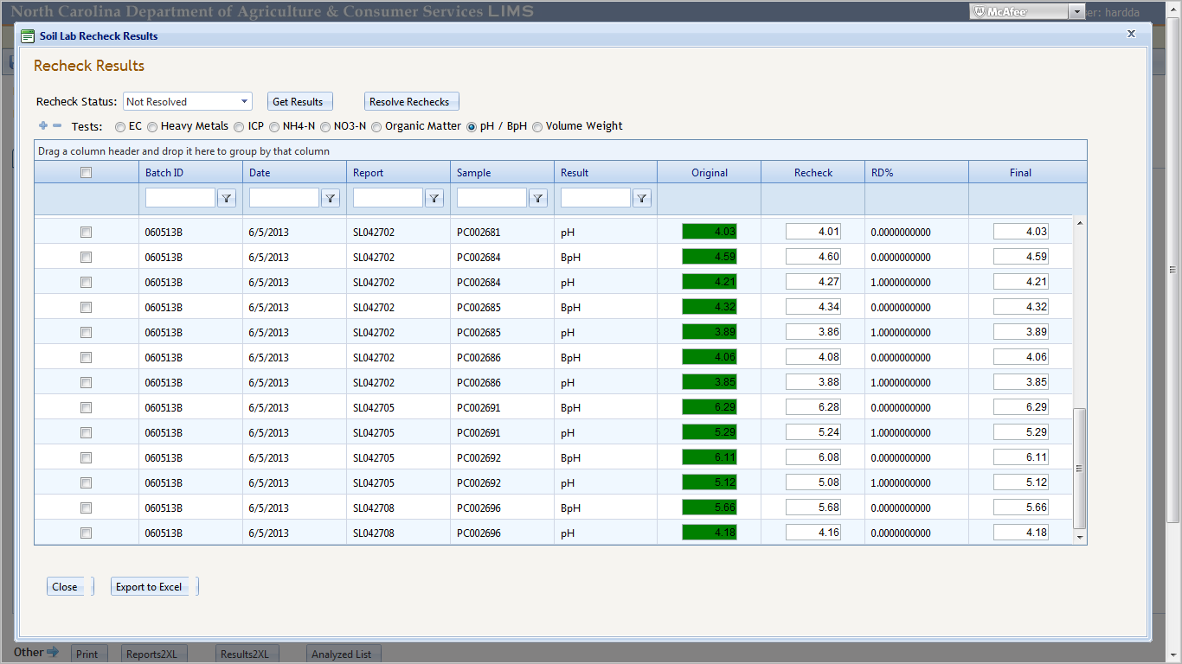
Recheck Results- pH Batch
Lab # pH/ BpH Original Recheck %RD Final

Slide 27
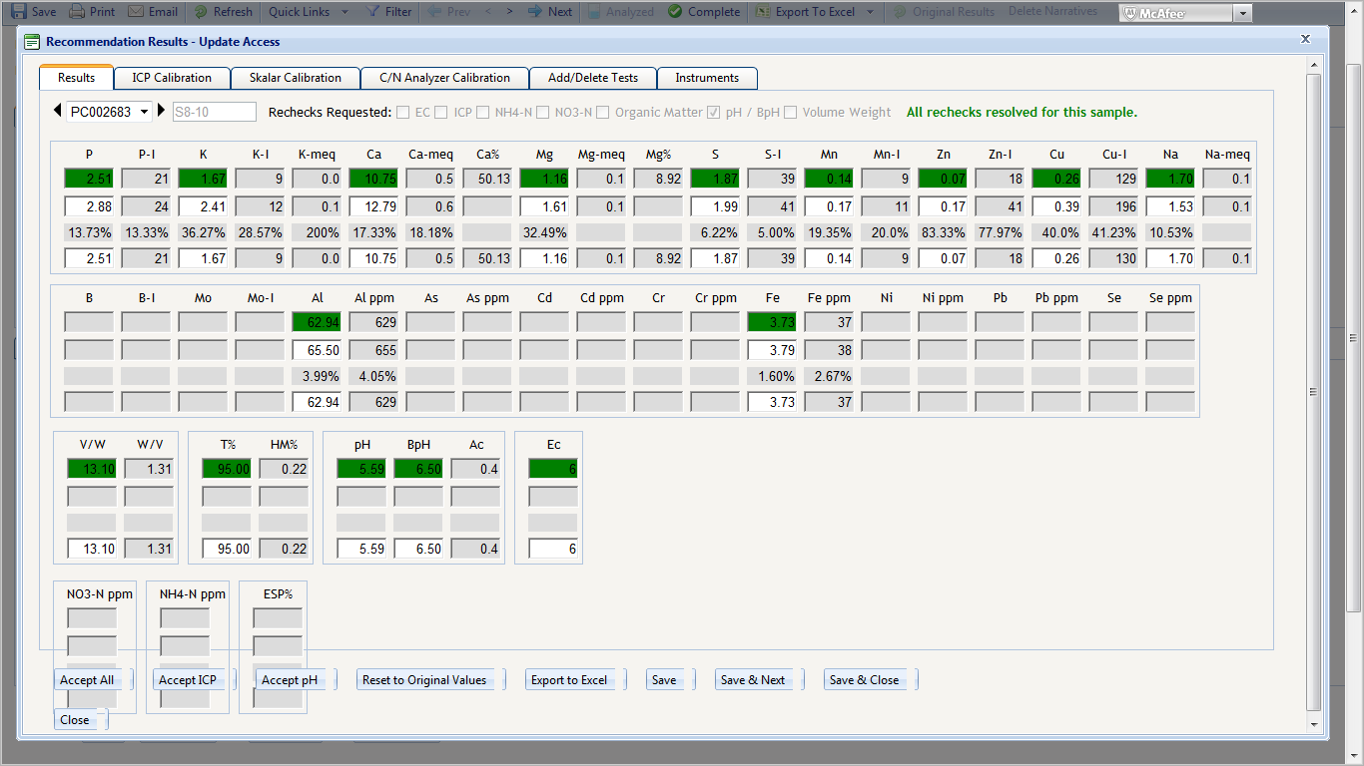
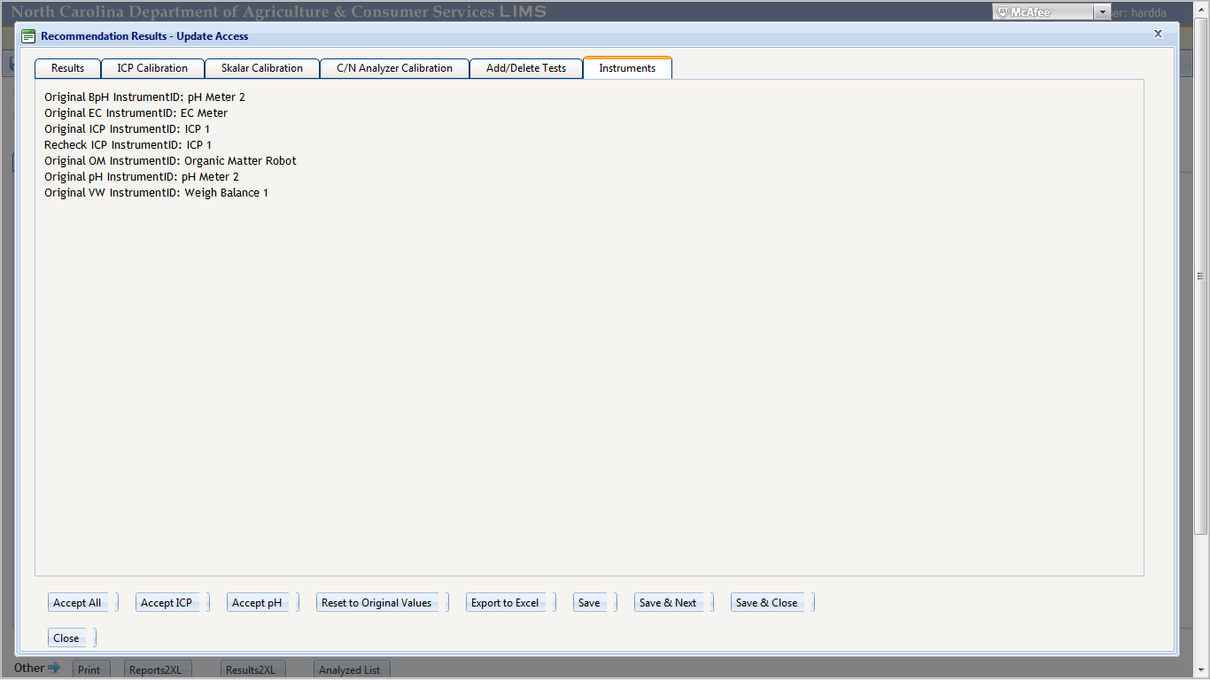

Slide 28
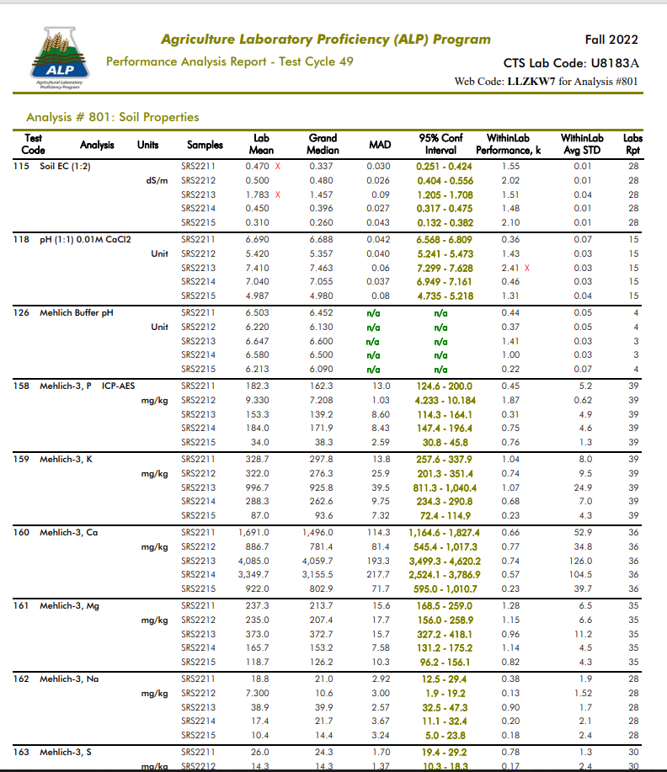
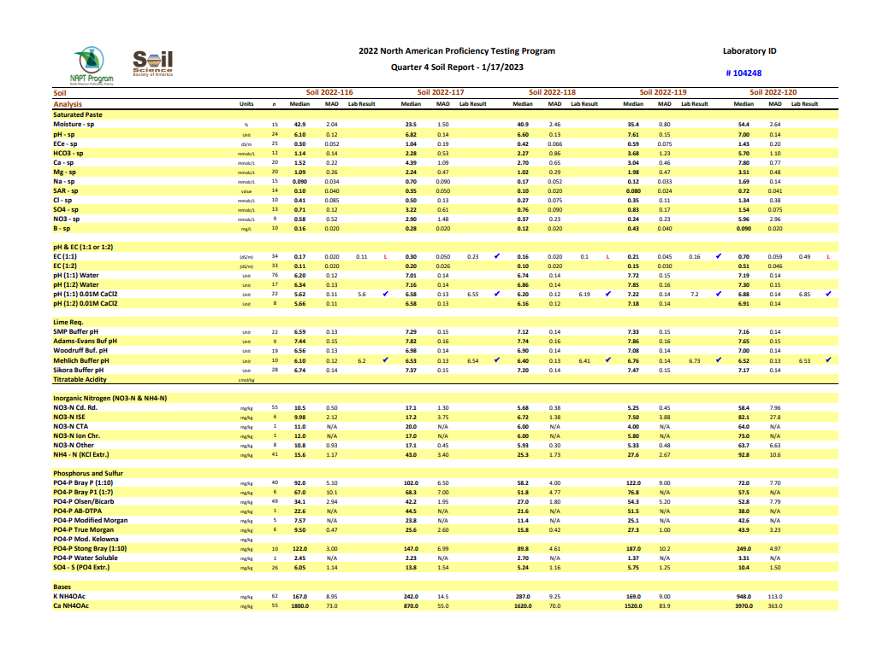
Proficiency Testing Programs
DENR Certified Lab – pH, P, Zn and Cu

Slide 29
Closing Comments
No lab is perfect……
Processes that safeguard errors
  SOPs
  Training
  Consistency……
Continuously monitoring processes
Investigate and try to remedy concerns
  Ask for help if needed

Slide 30
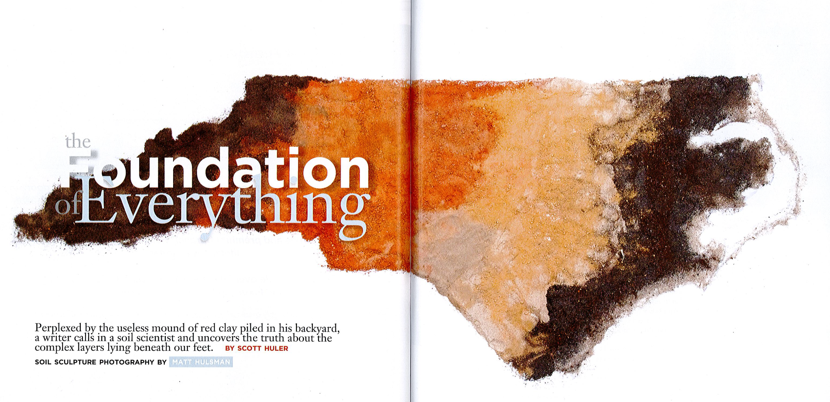

Slide 31


Slide 32
Items Discussed
Potential errors
Sample order
Labeling, color, ….
Logs and traceability
Standardization of instruments
ICP limits for extreme nutrient levels
Agronomist daily review of data
Control charts
Proficiency testing & NC Lab Certification

Slide 33
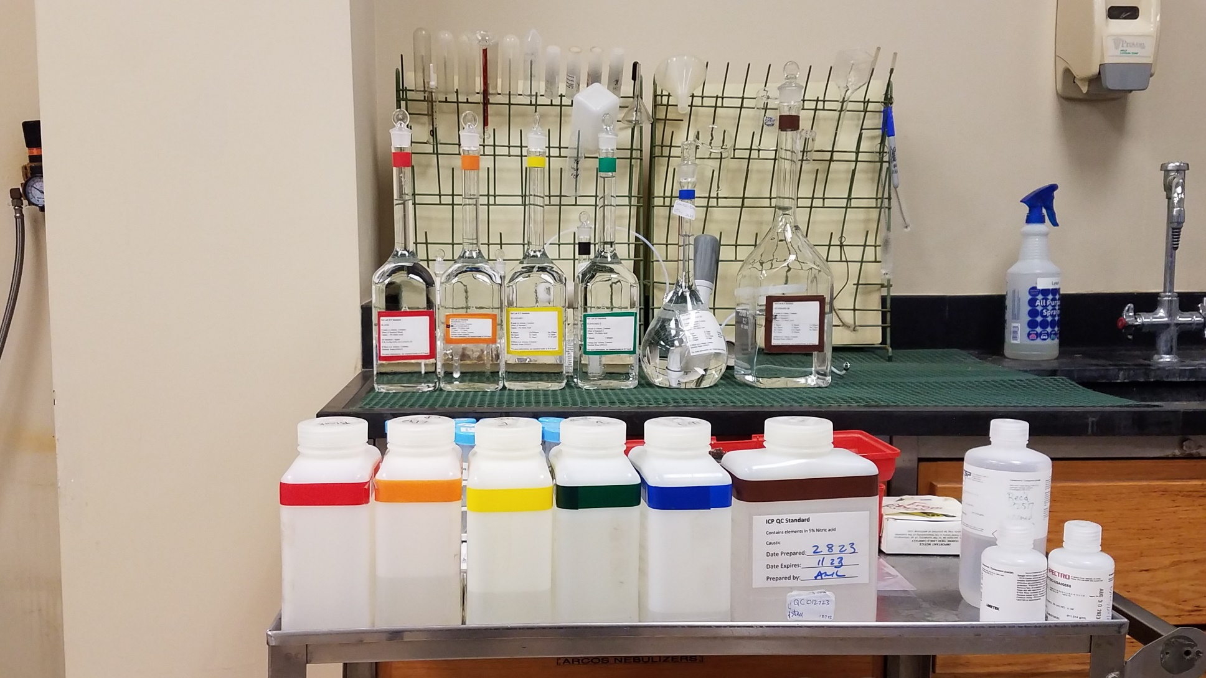

Slide 34
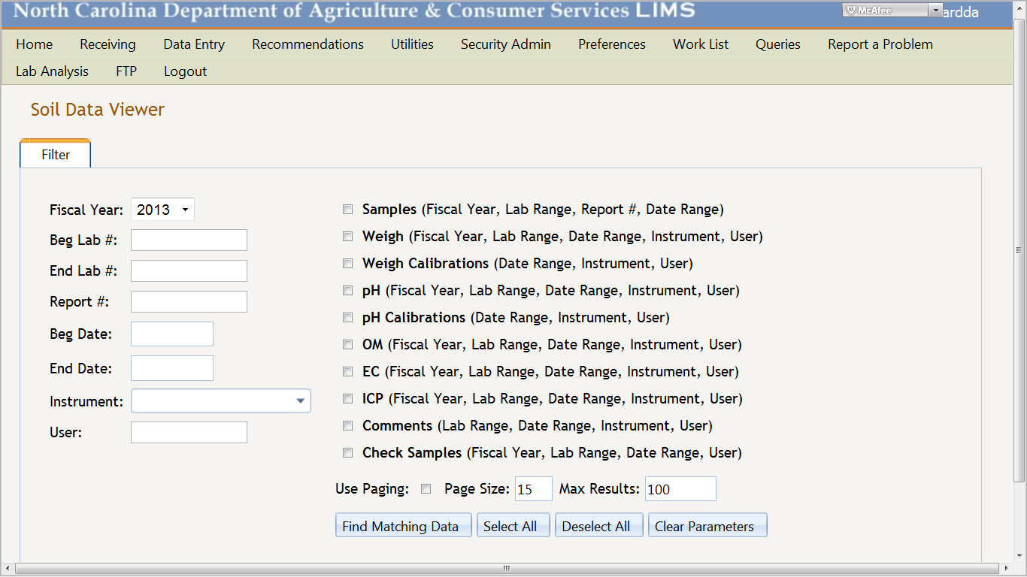
Traceability
Soil Data Viewer

